Slide 1

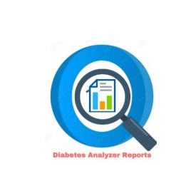
SKNSITS Department Of Computer Engineering
“Diabetic Report Analyzer”
Class:B.E. Academic Year:2022-23
Sub: Project Work Stage-I Review (2019 Course) Sub Code: 410248
Presented By
Dnyaneshwar Sonawane
Raj Pandharpatte
Prerna Bodakhe
Vaishanvi Punalkar
Name of Guide
Prof. Ravishankar Sir

Slide 2
Contents
Problem statement
Advancement in Technology pertaining to the selected project topic
Project Scope
Literature review
Model
Design
Output
References

Slide 3
Problem Statement
Doctors rarely on common knowledge for treatment. When common knowledge is lacking, studies are summarized after some number of cases have been studied. But this process takes time, whereas if machine learning is used, the patterns can be identified. For using machine learning, a huge amount of data is required. There is very limited amount of data available depending on the disease. Also the number of samples having no diseases is very high compared to number of sample

Slide 4
Advancement in Technology pertaining to the selected project topic
In this project use advancement technology as Machine Learning. Several machine learning algorithms are used to diagnoses diabetes and administering diabetes. This study focuses on new developments in machine learning which have made significant impacts in the detection and diagnosis of diabetes.
In this work, the machine learning algorithms are used to classifying diabetes patients. The classification accuracy is achieved by the classifying diabetes patients.
The advancement of this project is generating reports and recommendation to a user.

Slide 5
Literature Review
SR. NO | ORIGINATOR WITH TITLE | DATASET | ALGORITHM | TOOL | OUTCOME &ACCURACY
1 | Deepti Sisodia, Dilip Singh Sisodia.” Prediction Of Diabetes Using Classification Algorithm Prediction Of Diabetes Using Classification Algorithm” | PIDD | Decision tree, SVM and Naive Bayesian. | Weka | Diabetes detection at early stage. Accuracy 76%.
2 | Xue-Hui Meng,Yi-Xiang Huang,Dong- Ping Rao,Qiug Liu.” Comparison of three data mining models for predicting diabetes of prediabetes by rick factors” | To test 735 patients, they are came from two communities in Guangzhou, china | Logistic algorithm, ANN and Decision tree algorithms | Not Mentioned | Comparisons of three algorithms for predict the diabetes or prediabetes using common risk factors. The highest accuracy (77.87%) level is achieved by classification algorithm (C5.0).
3 | Monisha.A, S.ShalinChistina, Nirmala Santiago. “Decision support system for a chronic disease-Diabetes” | PIDD | Naive Bayes statistical modelling, logistic regression, Extreme Gradient Boosting | R programmi ng | The accuracy for Extreme Gradient Boosting algorithm is 81%
4 | S.Selvakumar, K.Senthamarai Kannan and S.GothaiNachiyar.” Prediction Of Diabetes Diagnosis Using Classification Based Data Mining Techniques” | Multi- dimensional healthcare dataset | Binary Logistic Regression, Multilayer perception and K-Nearest neighbor algorithms | Not mentioned | The accuracy level in Binary Logistic Regression is 0.69, Multilayer Perception is 0.71 and K-Nearest neighbour is 0.80.
5 | Aiswarya Iyar, S. Jeyalatha and RonakSumbaly, “Diagnosis Of Diabetes Using Classification Mining Techniques” | Pima Indians Diabetes Database of National Institute of Diabete | Decision tree and Naive Bayes algorithm | WEKA | The Naive Bayes algorithm is obtained 79.5652% of accuracy.
6 | B.Tamilvanan, Dr.V.MuraliBhaskaran, “An Experimental Study Of Diabetes Disease Prediction System Using Classification Techniques” | Medical database for diabetes Disease dataset from UCI. | Naive Bayes, Random Forest and NB-Tree | WEKA | The result is Naive Bayes has the best predictive capacity with highest accuracy rate (76.3%) and least error rate (23.7%).

Slide 6
Literature Review
SR. NO | ORIGINATOR WITH TITLE | DATASET | ALGORITHM | TOOL | OUTCOME &ACCURACY
7 | Rahul Joshi, Minyechil Alehegn,“Analysis and prediction of diabetes diseases using machine learning algorithm: Ensemble approach” | PIDD | KNN, Naive Bayes, Random Forest and J48 | Weka 3.8.1 and java using NetBeans 8.2 | To get the best result in ensemble approach, when combining individual techniques and methods. Also called hybrid model. This provide best performance and accuracy than the single one
8 | Amina Azar,YasirAli,Muhamma,Zaheer,” Data Mining Models Comparison for Diabetes Prediction" | PIDD | Decision tree, Naive Bayes and K-Nearest Neighbour algorithms | WEKA | The result of this paper is the decision tree is the best prediction algorithm. It gives the accuracy level is 75.65%.
9 | VeenaVijayan.V, Anjali.C,” Decision Support Systems for Predicting Diabetes Mellitus –A Review” | PIDD | Support Vector Machine (SVM), Naive Bayes classifier and Decision Tree. | WEKA | The accuracy variation with and without pre-processing techniques are also evaluated. Decision tree was constructed by including numerical discretization as a pre-processing technique in "Decision discovery for the diagnosis of Type
10 | Deepika Vema ,Dr.Nidhi Mishra, “Analysis the prediction of breast cancer and diabetes disease dataset using data mining classification techniques” | Breast cancer and diabetes disease dataset from UCI. | Naive Bayes, SMO, REP Tree, J48 and MLP algorithms. | WEKA | J48 achieves 74.28% accuracy level than the other algorithms on breast cancer dataset and SMO achieves 76.80% accuracy level on diabetes datasets.
11 | VeenaVijayan V, Anjali C, ”Prediction of diagnosis of diabetes mellitus –A machine learning approach” | Dataset obtained from UCI machine learning repository. | AdaBoost | Matlab – Weka | AdaBoost-decision stump classifiers are used to predict diabetes with low level error rate and its gives 80.729% of accuracy.
12 | AakanshaRathore, Simran Chauhan, Sakshi Gujral, “Detecting and Predicting Diabetes Using Supervised Learning: An Approach towards Better Healthcare for Women” | Pima | SVM and Decision Tree. | R-Studio | SVM gives the 82% of accuracy.

Slide 7
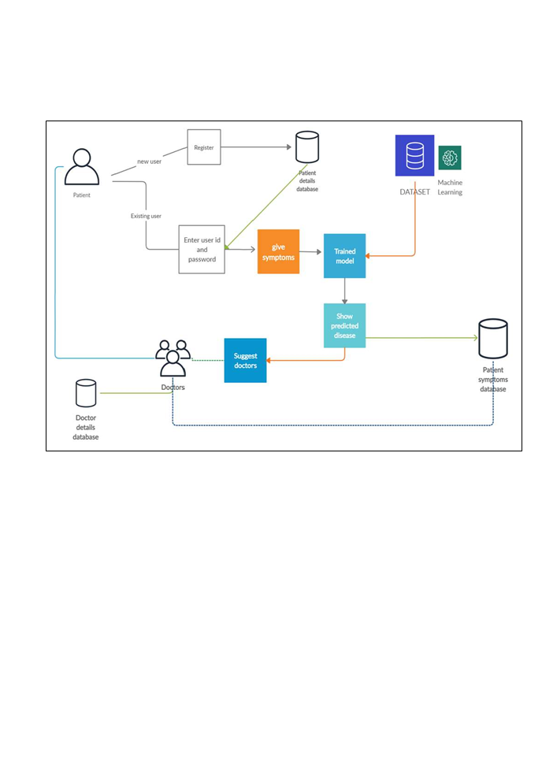
Model
1. Architecture Diagram

Slide 8
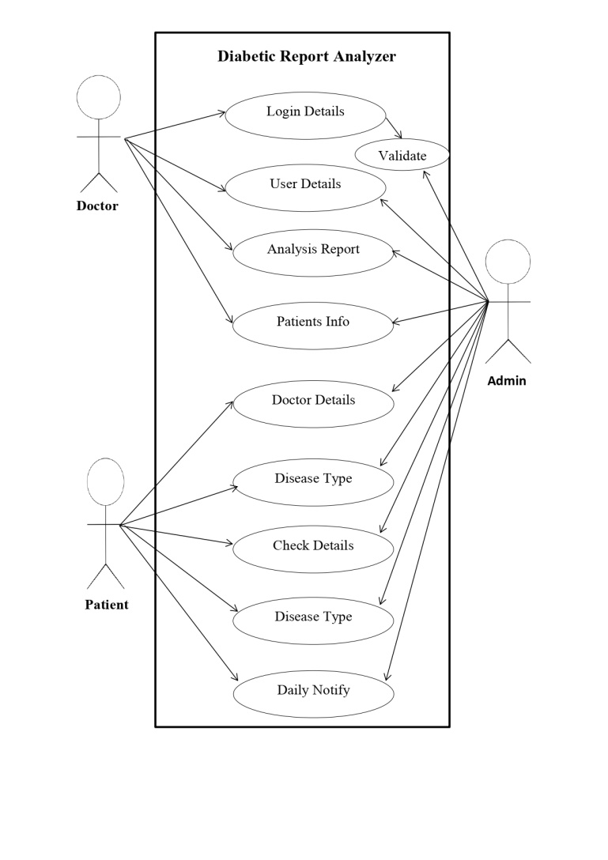
2. Use-case Diagram

Slide 9
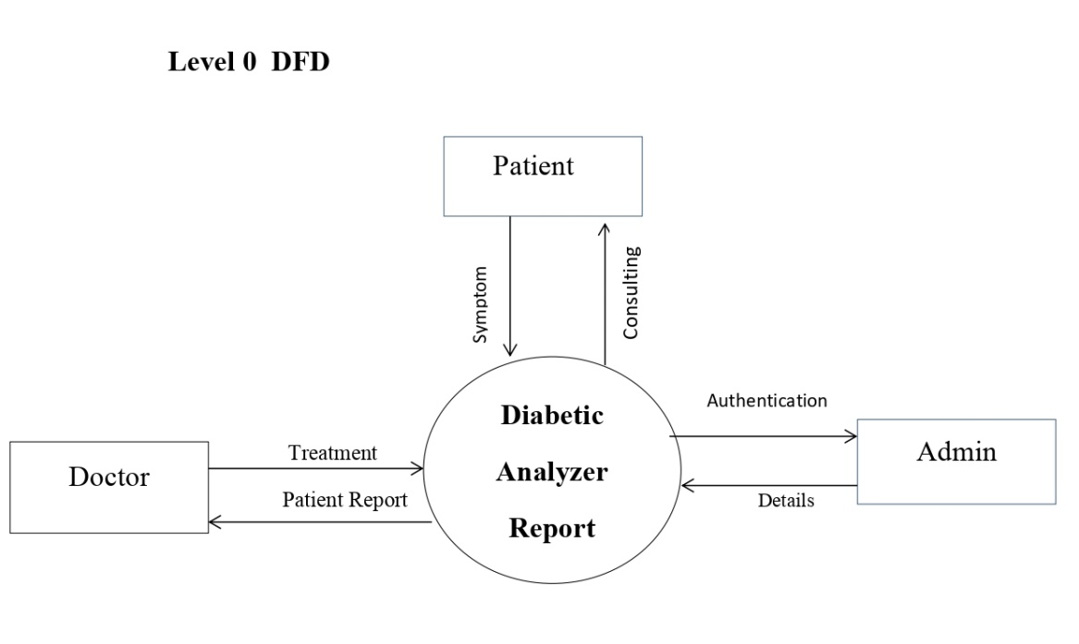
Design
Data Flow Diagram

Slide 10
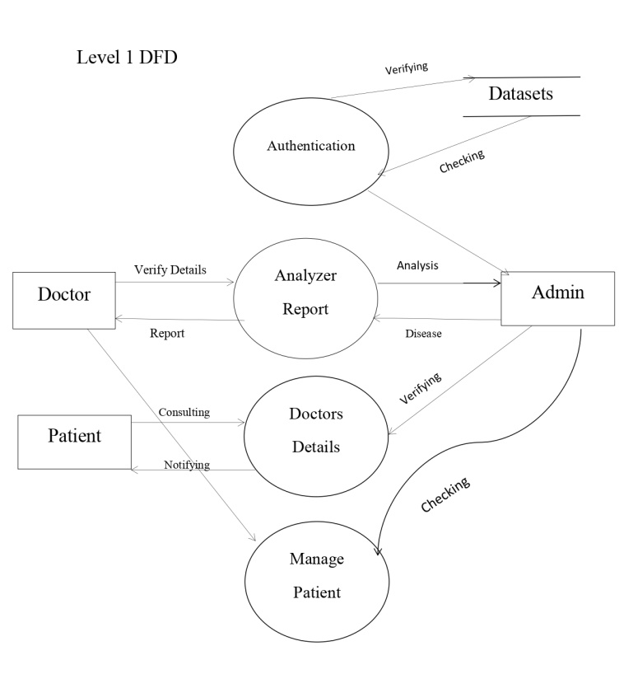

Slide 11

Outcome Of Projects
UI Design

Slide 12



Slide 13



Slide 14
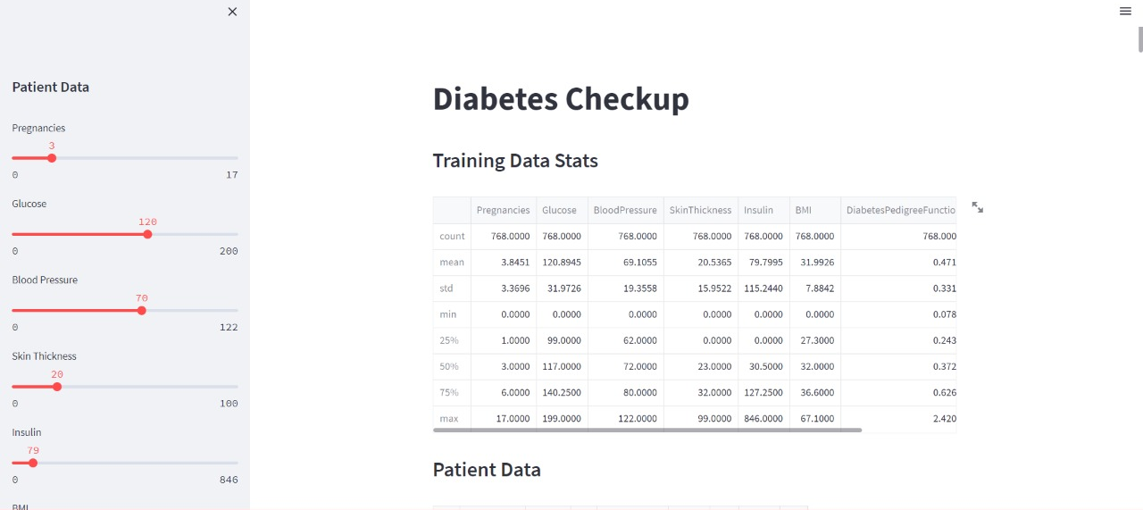
Outcome Of Project

Slide 15
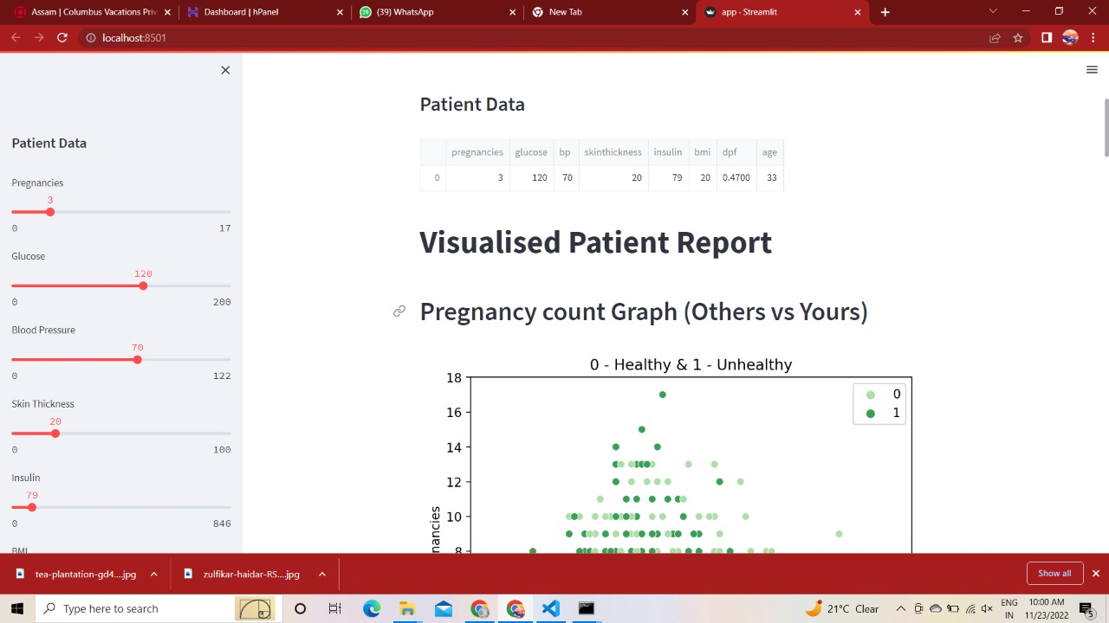
Outcome Of Project

Slide 16
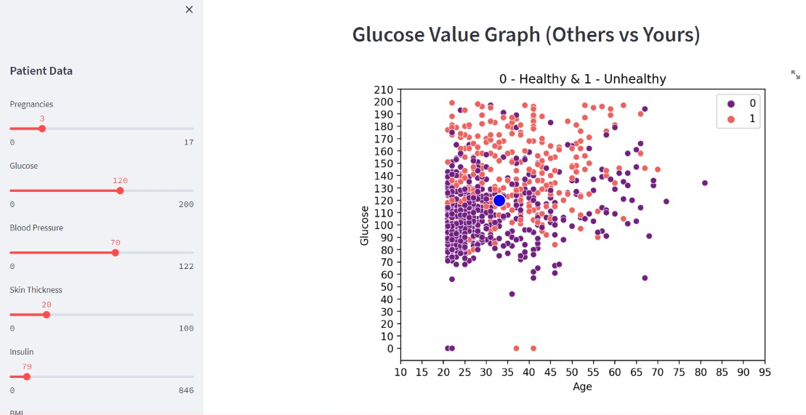
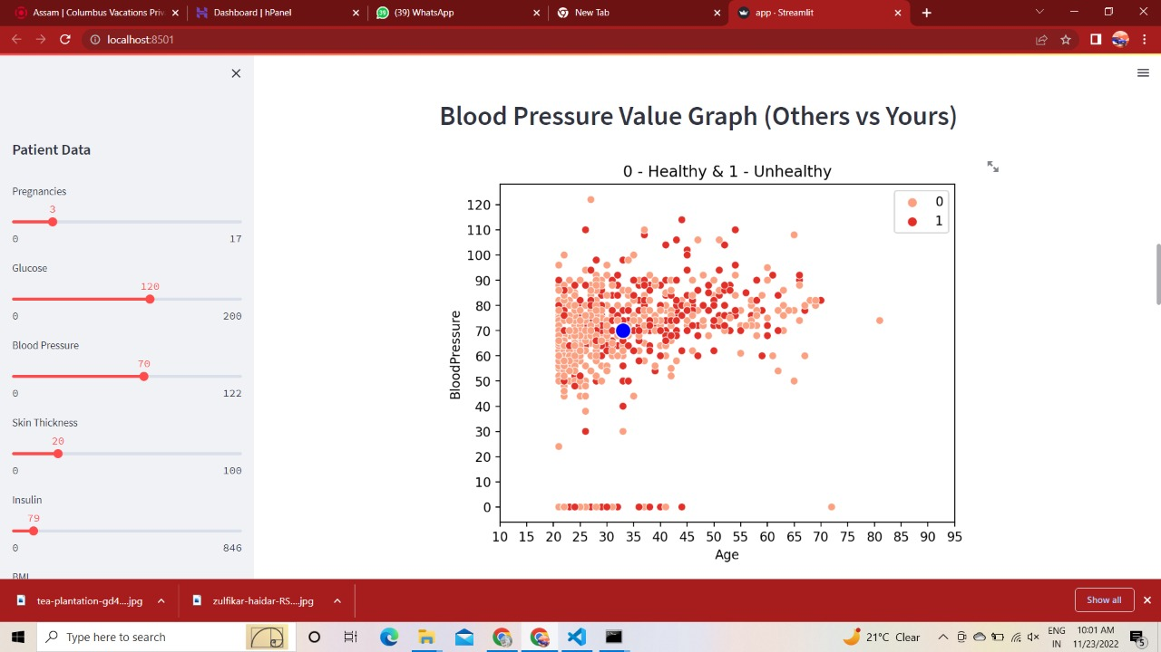

Slide 17
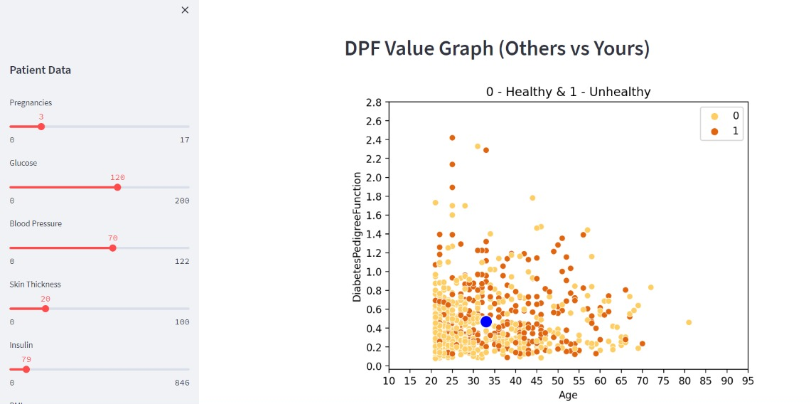

Slide 18
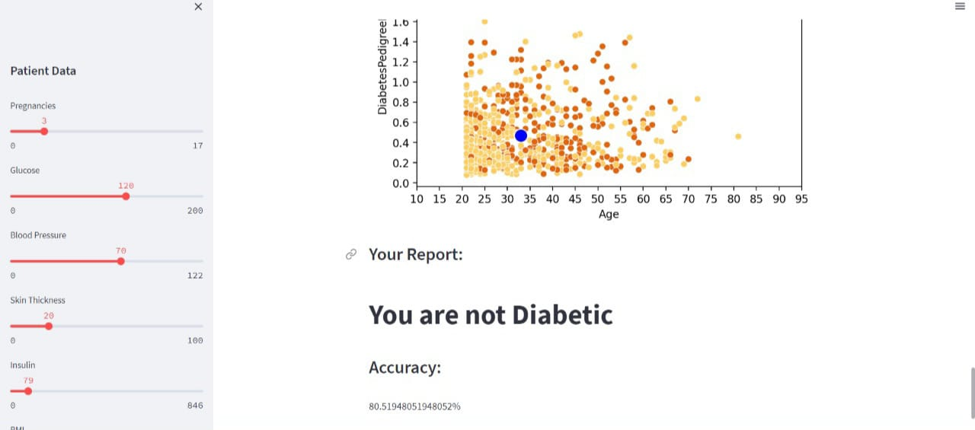

Slide 19
References
“Performance Analysis of Machine Learning Techniques to Predict Diabetes Mellitus” Md Faisal Faruque, Asaduzza man, Iqbal H. Sarker, IEEE 2019.
“A Comprehensive Exploration to the Machine Learning Techniques for Diabetes Identification” Sidong Wei1, Xuejiao Zhao, Chunyan Miao Shanghai Jiao Tong University, China.
“Association Rule Extraction from Medical Transcripts of Diabetic Patients” Lakshmi K S, G Santhosh Kumar, 2014.
“Diabetes Care Decision Support System” 2nd International Conference on Industrial and Information Systems IEEE 2010

